Slide 1
Dominion Pursuit
Final Iteration
Team members
Anil Karki
Bhuwan KC
Christopher Willingham

Slide 2
Team Vision
Our concept is to create a board game where players take turns to roll the dice for movement and choose one of three characters to move around the board in a predefined path, with the goal to have all 3 characters on the final space.

Slide 3
Competitors
Snakes and ladders
The Game of Life
Trouble
Risks
Learning new game engine - We spent almost a 2 hours a week for a month.
AI optimization- Spent almost 10 hours.
Game balance- Spent almost 3 hours.

Slide 4
Features Schedule
Iteration 1
Setup game components
Dice roll mechanism
Character movement
Character status update
Iteration 2
Character graphics design
Characters’ detail design
Turnwise dice roll event
Multi-character status bar
Iteration 3
Multi-character gameplay
Characters’ interactions
Basic AI system
Menu system
Iteration 4
Event cards implementation
Characters selection
Sound effects
Game optimizations

Slide 5
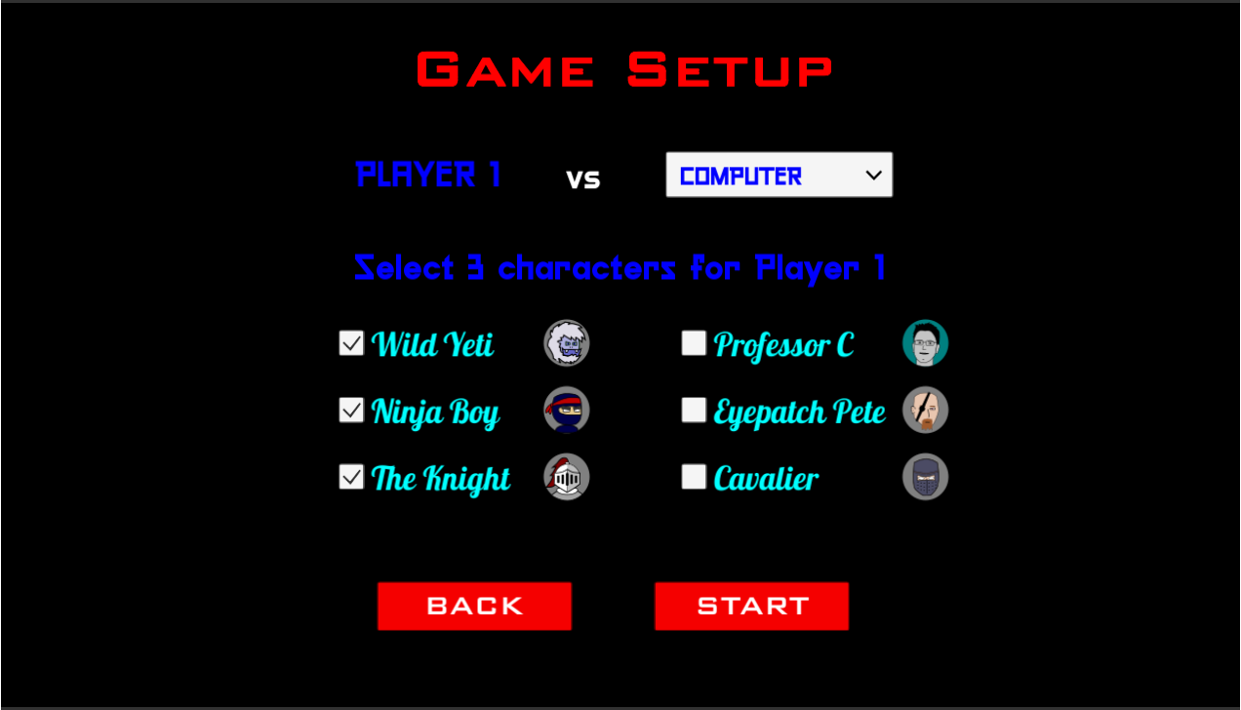
Features Added in the Final Iteration
Sound Effects - Sounds have been added throughout the game. These range from background music to various sound effects.
Character Selection - Players can now select what characters they wish to have on their team.

Slide 6
Final Features Continued
Event Cards - Players start the game with 2 event cards, and can gain more from landing on specific tiles scattered across the board. Before a player rolls the dice, they can choose to play an event card. These event cards have varying effects, ranging from changing a characters health to influencing their location on the board.
AI - the AI was made more intelligent to better pose a challenge to the player, utilizing event cards and intelligent decisions on what character to move.
Event cards are part logical, part random
No AI personalities

Slide 7
Demo

Slide 8
GitHub Link
https://github.com/ablaze007/DominionPursuit

